Slide 1
Business, Marketing, Entrepreneurship, Digital Marketing, and Econ Mrs. Schafer

Slide 2
Getting into Marketing
Marketing Quick Facts
4 Ps
Target Market Exercise
Coca-Cola Video
Tesla Video
Pricing Reading

Slide 3
Crazy Facts About Marketing
Why is Marketing Important and how is it changing in the 21st century?
Today, 1.6 billion people are accessing the web from a mobile device. That number is increasing exponentially every year. (Mobify, 2018)
Email, website and social media are the top three marketing tools used by small businesses: 54% email, 51% website, 48% social media (BlueCorona Marketing, 2018).
Depending on the product, up to 83% of consumers visit a company’s or service provider’s website before making a purchase (M&R Marketing Group, 2018).
As the digital age progresses, the consumer’s attention span shrinks: Consumer’s average attention span today is only 8 ^{seconds dropping 4 second} since 2000 (MicrosoftCorp., 2017) .

Slide 4

Lemonade Stand Marketing
Marketing is all around us!

Slide 5
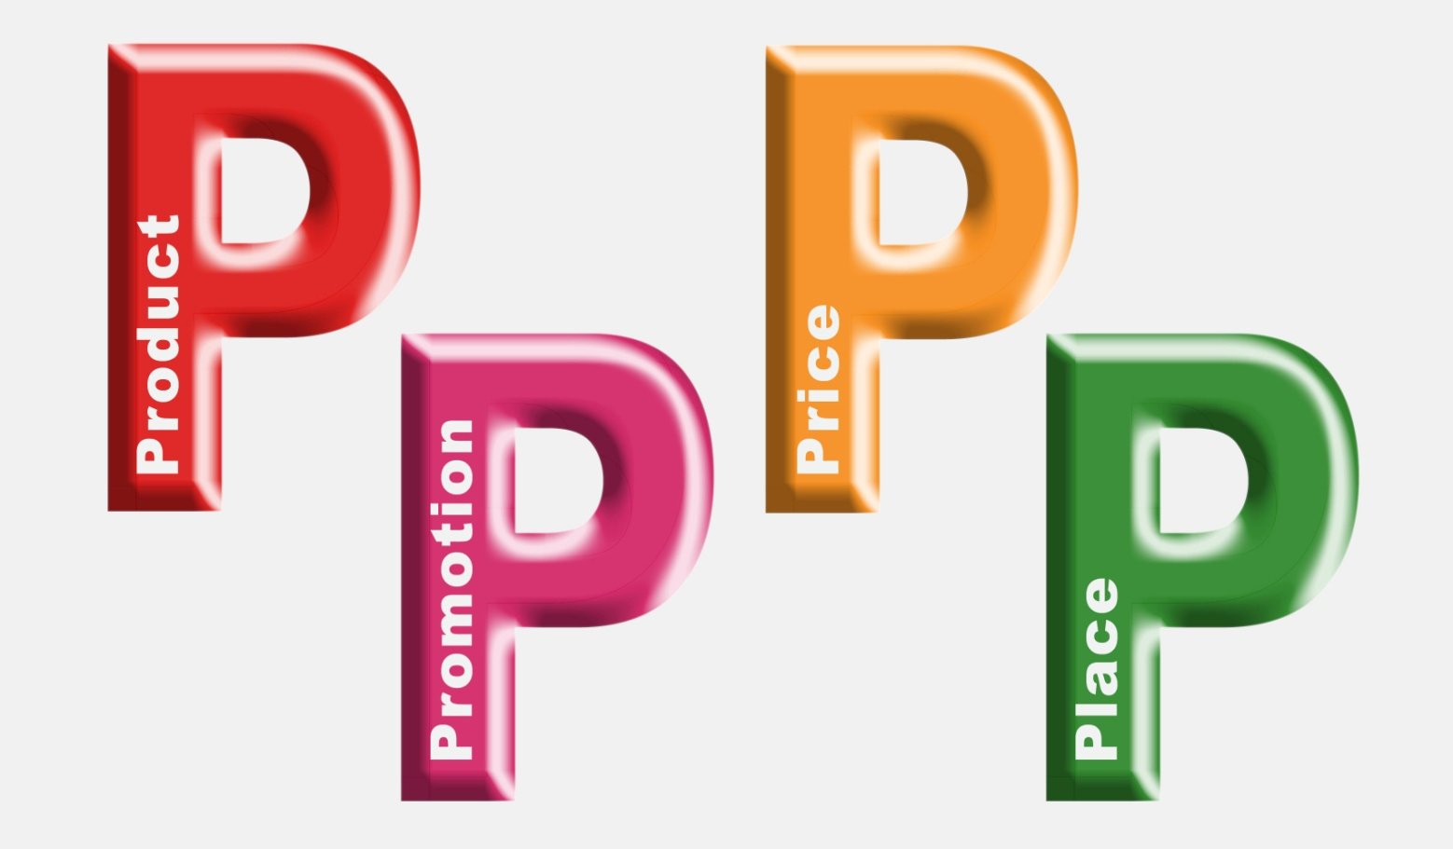
Marketing is the Four Ps
http://www.youtube.com/watch?v=JIirzTdaey4
Notes:
http://www.youtube.com/watch?v=JIirzTdaey4
5 min video
(picture is a YouTube video to an explanation about the 4 P’s)
Write the 4 questions on the board
Next, ask students to help you out as you cross out each of the questions you
initially wrote on the board and replace it with one of the 4 Ps as follows:
What? Where? How much? How will you tell people?
Product Place Price Promotion
Finally, address the Who? question. Explain that many marketers consider
People to be the fifth P because it is so important to know who your target
market is in order to figure out the best strategy for each of the other 4 Ps. This
is why the question Who will buy it? appears in the middle of the diagram on
the handout. When you develop an idea of who your average customer is, you
are creating what is known as a customer profile. The better you understand your
customers, the more successful your marketing plan is likely to be.

Slide 6
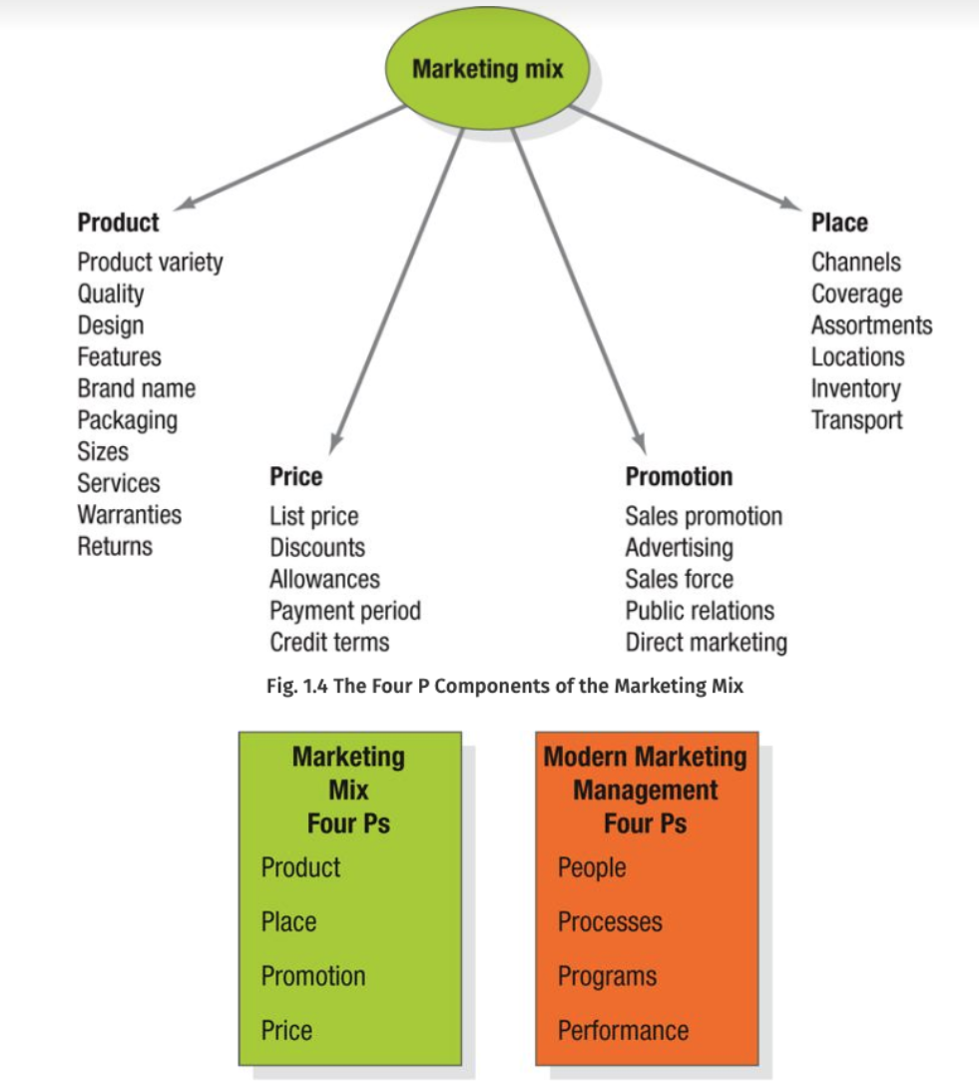

Slide 7
Product
Decide what products to make and sell.
Product design
Features
Brand name
Packaging
Service
Warranty

Slide 8
Product Packaging is important! Sometimes the packaging is the best part!
Send a Cake
Star Wars Propel Drone
Notes:
https://www.youtube.com/watch?v=KMgbMg18mgo
https://www.youtube.com/watch?v=4fdOymG2cds

Slide 9
Place
Getting the product into the consumer’s hand.
Must know:
Where and how the customer shops
How and where the product will be distributed
Sell directly to the customer or through intermediaries?
How to attract the customer
Notes:
How and where the product will be distributed: For global companies, it may mean making decisions about which products will be sold in which countries and which retail outlets or other means of selling the product will best reach the customer.

Slide 10

Price
Must understand what price point to sell the product or service.
Price strategies:
What are customers willing and able to pay?
What is the competition offering the customers?
Do customers find value in the product or service?
Promotional pricing? → Buy one get one, buy one get one half off, etc.

Slide 11
Promotion
How will people know about your stand? Think of promotion tactics to bring you more business.
Promotion strategies:
Selling
Advertising
Sales promotion
Direct marketing
Publicity

Slide 12
Neurology of Branding (The power of promotion): How Apple and Nike have branded your brain | Your Brain on Money | Big Think - YouTube
Notes:
https://www.youtube.com/watch?v=4eIDBV4Mpek

Slide 13
Impact of Happiness on Purchase Decisions
Why We Make Bad Decisions.
This TED Talk is about the impact of happiness on purchase decisions.
The surprising science of happiness | Dan Gilbert
Notes:
Six Ways to Create Better Customer Behavior Analytics. This blog post discusses how to use analytics to better determine consumer behavior. https://www.datameer.com/blog/six-ways-create-better-customer-behavior-analytics/
Predictive Analytics: Predicting Customer Behavior to Improve ROI. This article discusses predictive analytics as applies to consumer behavior. https://www.hausmanmarketingletter.com/predictive-analytics-improve-roi/

Slide 14
Questions to Consider
Who will buy it?
What, specifically, will you sell?
Where will you sell it?
How much will you charge?
How will you tell people about it?
What?
What kind of lemonade/food will you sell?
Will you have different options or flavors available?
Will you offer different sizes?
What kinds of cups/utensils will you use?
Where?
Where will you set up your stand/truck?
Why did you choose these locations?
How much?
How did you establish the price of your lemonade/food?
Did you consider potential competition or the cost to make?
Did you consider how much money your customers might have with them?
How will you tell people?
How will you tell people about your stand?
What makes you think your promotional plan will be effective?
Notes:
As students are working, write the following terms on the board:
What? Where? How much? How will you tell people?
Once the lists are complete, explain to students that each of these questions
addresses one of the fundamental cornerstones of marketing, the 4 Ps. Briefly
explain the 4 Ps to them.

Slide 15
Place:
Price:
Promotion:
Product:
=Target Market
Notes:
Ask 4 separate people to create a P without the others seeing, write on post it note. Pass it to the front and someone in class puts them all on a chart
Others in class figure out who the target market might be

Slide 16
you have 30 seconds…. Pick up an item from within This Room
Notes:
Who is the target market for that product

Slide 17
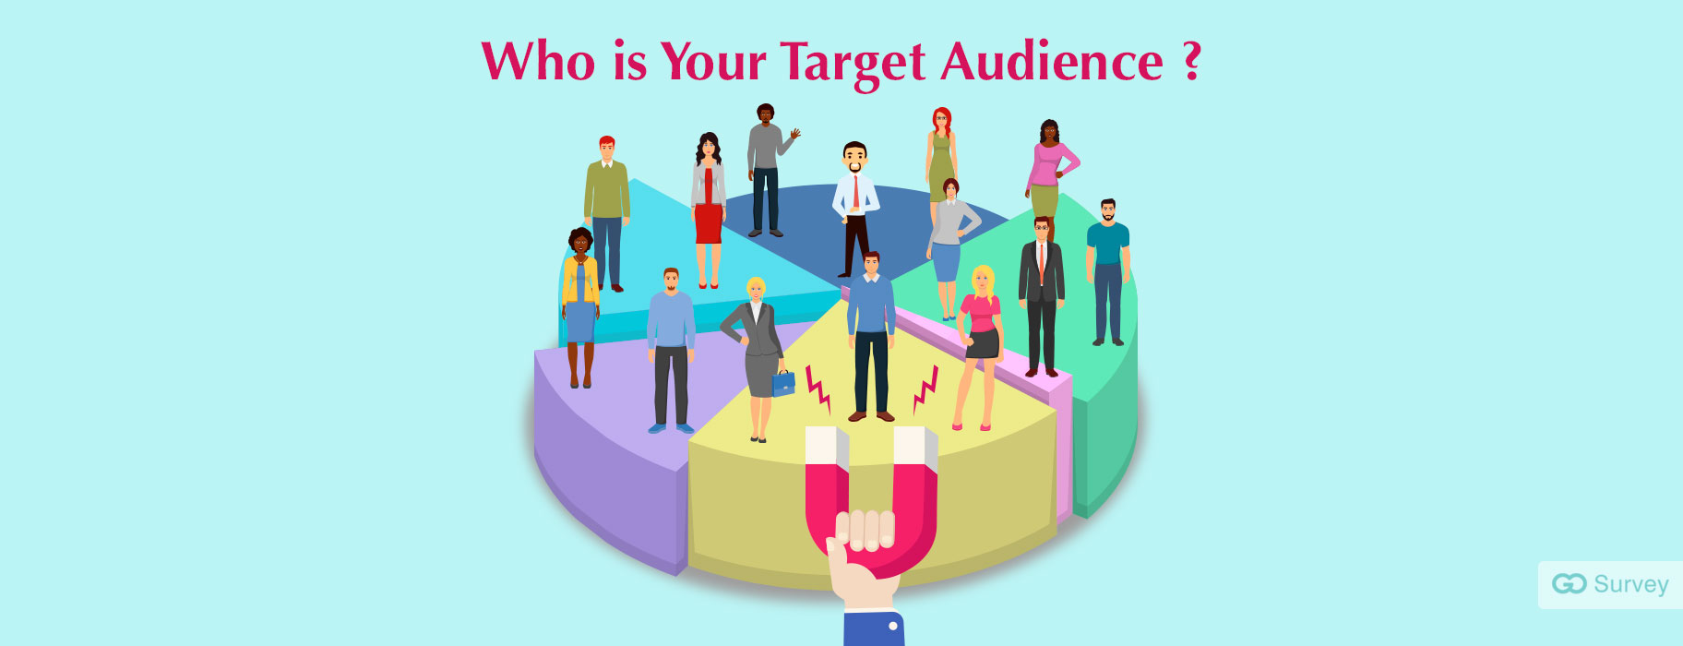
Target Market
Group of potential customers to whom a company wants to sell its products and services
Part of the larger consumer market or total market for a good or service
Specific customers to whom a company directs its marketing efforts

Slide 18
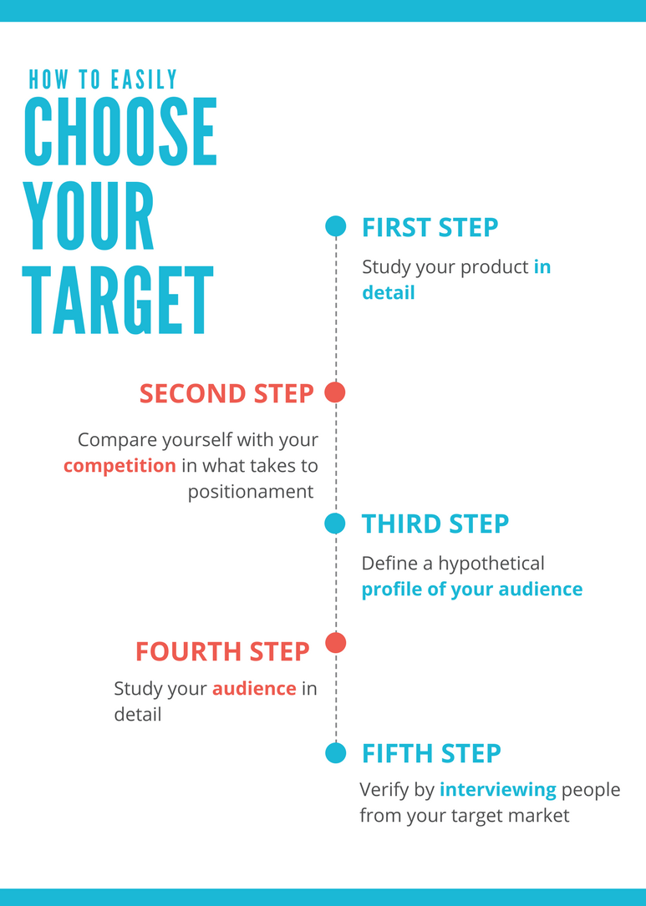

Slide 19
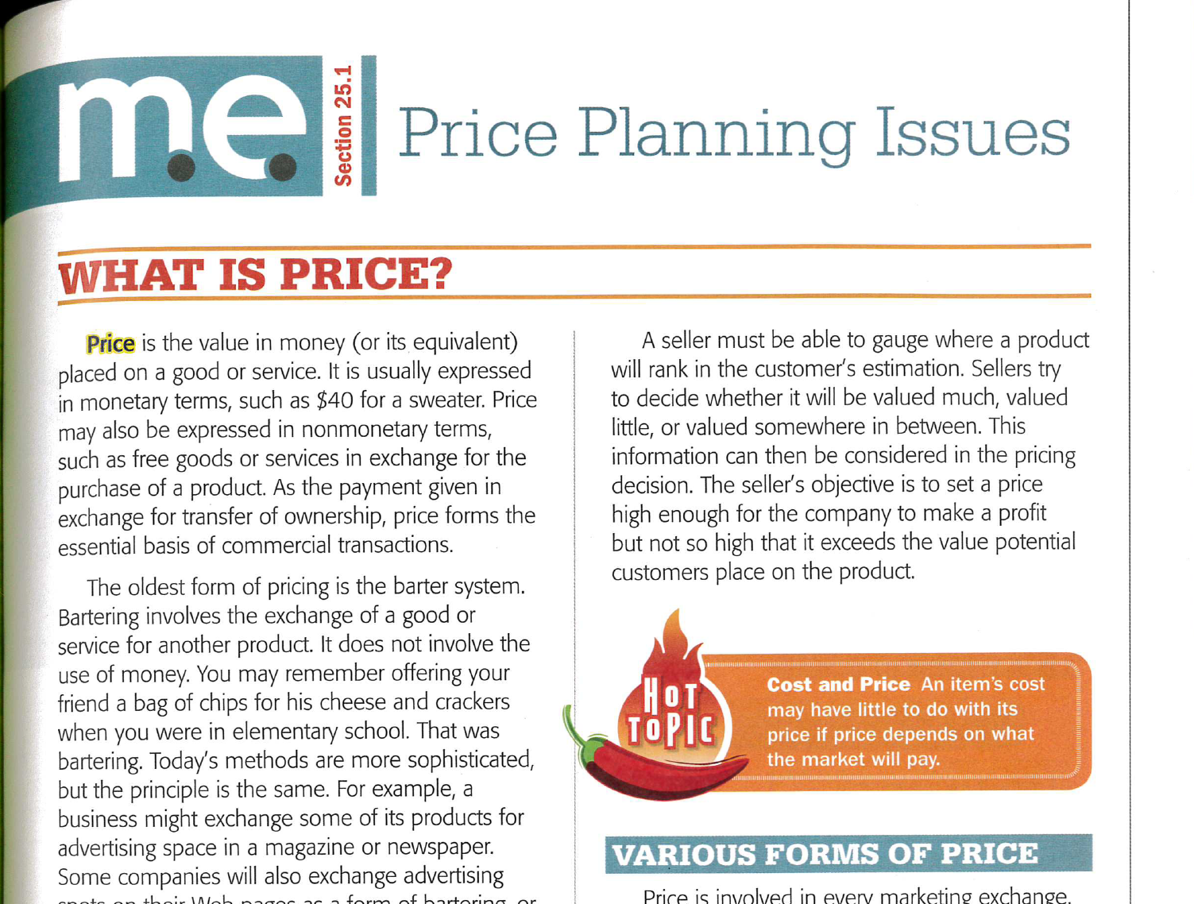
Assignment
Read the pricing section of the marketing textbook (PDF)
Note all of the terms in the text for the next exam
You do NOT have to answer the questions at the end of the pages

Slide 20
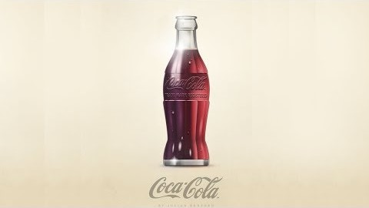
Notes:
The Secret Behind Coca-Cola Marketing Strategy – YouTube 8 minutes
https://www.youtube.com/watch?v=XhMVWzVXNNk
Instructions: write a one word or partial sentence answer for each question. You should be able to answer all of these while you’re watching the video.
How many bottles of coke were sold per day when first starting out? What does this tell you about starting out in your entrepreneurial endeavors?
Instead of focusing on selling just a drink, what does Coke focus on selling in all, or most, of its advertising campaigns?
What is one example of something Coke did to develop their “sharing campaign”.
Which of the 4Ps (product, promotion, price, place) did this specific technique utilize?
What did Coke do to personalize their product?

Slide 21

Notes:
Elon Musk Spends 0$ on Marketing - Tesla's Marketing Breakdown – YouTube
https://www.youtube.com/watch?v=tF9r9LrOb70&t=2s
Instructions: write a one word or partial sentence answer for each question. You should be able to answer all of these while you’re watching the 8-minute video.
1. With what social media company do auto companies spend most of their ad money?
2. How much money does Tesla spend on Facebook, Instagram, Twitter, and YouTube?
3. What does the video say you have to do to get free publicity?
4. What do customer advocates do for a company?

Slide 22
Most valuable brands from 2000-2022
Animated: The Most Valuable Brands From 2000–2022 (visualcapitalist.com)
Notes:
Animated: The Most Valuable Brands From 2000–2022 (visualcapitalist.com)
Animated: The Most Valuable Brands From 2000–2022 (visualcapitalist.com)

